Slide 1
Lecture #3
SOFT COMPUTING
INT508

Slide 2
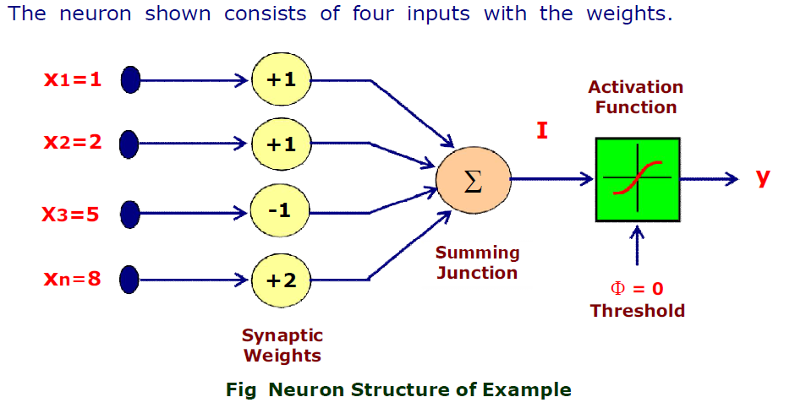
Classification of ANNs

Slide 3
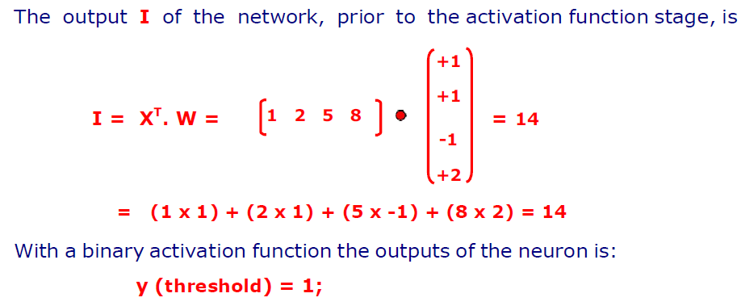
Classification of ANNs

Slide 4
Classification of ANNs
A network topology is the arrangement of a network along with its nodes and connecting lines. According to the topology, ANN can be classified as the following kinds −
Feedforward Network:
It is a non-recurrent network having processing units/nodes in layers and all the nodes in a layer are connected with the nodes of the previous layers.
The connection has different weights upon them.
There is no feedback loop means the signal can only flow in one direction, from input to output.
It may be divided into the following two types −
1. Single layer feedforward network
2. Multilayer feedforward network

Slide 5
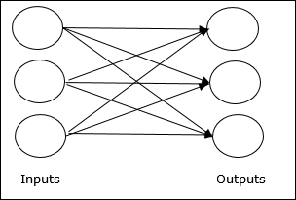
Classification of ANNs
Single layer feedforward network:
The concept is of feedforward ANN having only one weighted layer.
In other words, we can say the input layer is fully connected to the output layer.

Slide 6
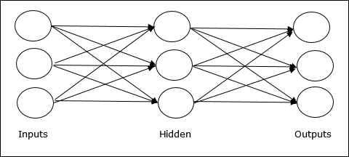
Classification of ANNs
Multy layer feedforward network:
The concept is of feedforward ANN having more than one weighted layer.
As this network has one or more layers between the input and the output layer, it is called hidden layers.

Slide 7
Classification of ANNs
Feedback Network:
As the name suggests, a feedback network has feedback paths, which means the signal can flow in both directions using loops.
This makes it a non-linear dynamic system, which changes continuously until it reaches a state of equilibrium.
Recurrent networks: They are feedback networks with closed loops. Following are the two types of recurrent networks.

Slide 8
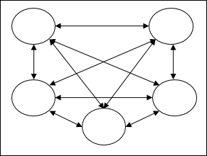
Classification of ANNs
1. Fully recurrent network: It is the simplest neural network architecture because all nodes are connected to all other nodes and each node works as both input and output.

Slide 9
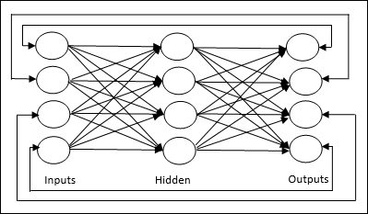
Classification of ANNs
2. Jordan network − It is a closed loop network in which the output will go to the input again as feedback as shown in the following diagram.

Slide 10
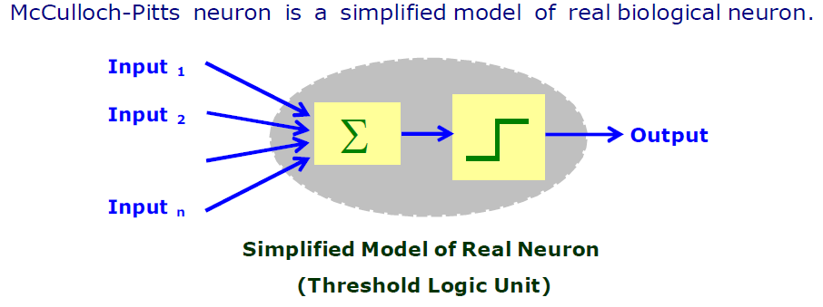
McCulloch-Pitts(MCP) neuron model

Slide 11
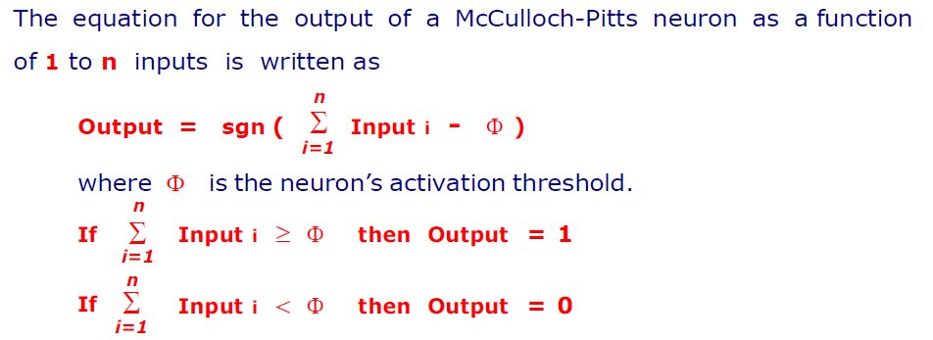
McCulloch-Pitts neuron model

Slide 12
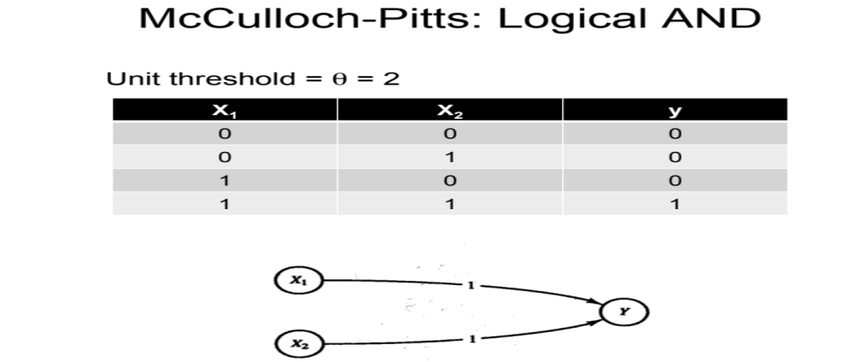
McCulloch-Pitts neuron model
x1*w1+x2*w2=sum
0*1+0*1=0
0*1+1*1=1
1*1+0*1=1
1*1+1*1=2

Slide 13
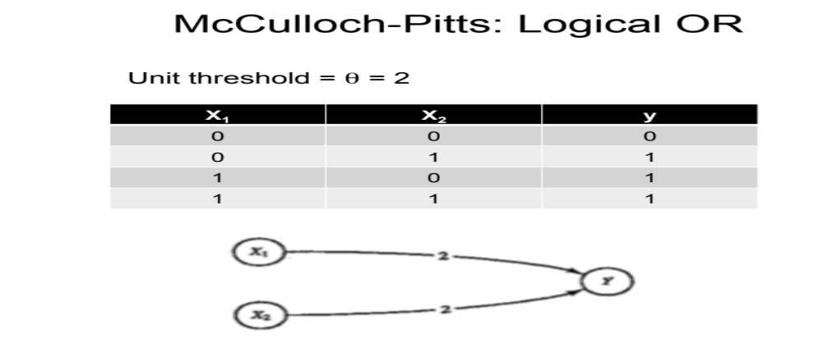
McCulloch-Pitts neuron model
x1*w1+x2*w2=sum
0*2+0*2=0
0*2+1*2=2
1*2+0*2=2
1*2+1*2=4

Slide 14
Q & A
1. What will be threshold value for or function using McCulloch Pitts neural network:
0
1
2
Not Solvable

Slide 15
Q & A
1. What will be threshold value for or function using McCulloch Pitts neural network:
0
1
2
Not Solvable

Slide 16
Q & A
2. What will be threshold value for and function using McCulloch Pitts neural network:
0
1
2
Not Solvable

Slide 17
Q & A
2. What will be threshold value for and function using McCulloch Pitts neural network:
0
1
2
Not Solvable

Slide 18
Q & A
3. What was the name of the first model which can perform wieghted sum of inputs?
a) McCulloch-pitts neuron model
b) Marvin Minsky neuron model
c) Hopfield model of neuron
d) none of the mentioned

Slide 19
Q & A
3. What was the name of the first model which can perform wieghted sum of inputs?
a) McCulloch-pitts neuron model
b) Marvin Minsky neuron model
c) Hopfield model of neuron
d) none of the mentioned

Slide 20

12/12/14
CSE510, Lovely Professional University, Phagwara

